Slide 1
DATA MINING LECTURE 5
Similarity and Distance

Slide 2
SIMILARITY AND DISTANCE
Thanks to:
Tan, Steinbach, and Kumar, “Introduction to Data Mining”
Rajaraman and Ullman, “Mining Massive Datasets”

Slide 3
Similarity and Distance
For many different problems we need to quantify how close two objects are.
Examples:
For an item bought by a customer, find other similar items
Group together the customers of site so that similar customers are shown the same ad.
Group together web documents so that you can separate the ones that talk about politics and the ones that talk about sports.
Find all the near-duplicate mirrored web documents.
Find credit card transactions that are very different from previous transactions.
To solve these problems we need a definition of similarity, or distance.
The definition depends on the type of data that we have

Slide 4
Similarity
Numerical measure of how alike two data objects are.
A function that maps pairs of objects to real values
Higher when objects are more alike.
Often falls in the range [0,1], sometimes in [-1,1]
Desirable properties for similarity
s(p, q) = 1 (or maximum similarity) only if p = q. (Identity)
s(p, q) = s(q, p) for all p and q. (Symmetry)

Slide 5
Similarity between sets
Consider the following documents
Which ones are more similar?
How would you quantify their similarity?
apple releases new ipod
apple releases new ipad
new apple pie recipe

Slide 6
Similarity: Intersection
Number of words in common
Sim(D,D) = 3, Sim(D,D) = Sim(D,D) =2
What about this document?
Sim(D,D) = Sim(D,D) = 3
apple releases new ipod
apple releases new ipad
new apple pie recipe
Vefa releases new book with apple pie recipes

Slide 7
Jaccard Similarity
The Jaccard similarity (Jaccard coefficient) of two sets S₁, S₂ is the size of their intersection divided by the size of their union.
JSim (C₁, C₂) = |C₁∩C₂| / |C₁∪C₂|.
Extreme behavior:
Jsim(X,Y) = 1, iff X = Y
Jsim(X,Y) = 0 iff X,Y have not elements in common
JSim is symmetric
3 in intersection.
8 in union.
Jaccard similarity
= 3/8

Slide 8
Similarity: Intersection
Number of words in common
JSim(D,D) = 3/5
JSim(D,D) = JSim(D,D) = 2/6
JSim(D,D) = JSim(D,D) = 3/9
apple releases new ipod
apple releases new ipad
new apple pie recipe
Vefa rereases new book with apple pie recipes

Slide 9
Similarity between vectors
Documents (and sets in general) can also be represented as vectors
document | Apple | Microsoft | Obama | Election
D1 | 10 | 20 | 0 | 0
D2 | 30 | 60 | 0 | 0
D2 | 0 | 0 | 10 | 20
How do we measure the similarity of two vectors?
How well are the two vectors aligned?

Slide 10
Cosine Similarity
Sim(X,Y) = cos(X,Y)
The cosine of the angle between X and Y
If the vectors are aligned (correlated) angle is zero degrees and cos(X,Y)=1
If the vectors are orthogonal (no common coordinates) angle is 90 degrees and cos(X,Y) = 0
Cosine is commonly used for comparing documents, where we assume that the vectors are normalized by the document length.

Slide 11
Cosine Similarity - math
If d₁ and d₂ are two vectors, then
cos( d₁, d₂ ) = (d₁ • d₂) / ||d₁|| ||d₂|| ,
where • indicates vector dot product and || d || is the length of vector d.
Example:
d₁ = 3 2 0 5 0 0 0 2 0 0
d₂ = 1 0 0 0 0 0 0 1 0 2
d₁ • d₂= 3*1 + 2*0 + 0*0 + 5*0 + 0*0 + 0*0 + 0*0 + 2*1 + 0*0 + 0*2 = 5
||d₁|| = (3*3+2*2+0*0+5*5+0*0+0*0+0*0+2*2+0*0+0*0)^{0.5} = (42) ^{0.5} = 6.481
||d₂|| = (1*1+0*0+0*0+0*0+0*0+0*0+0*0+1*1+0*0+2*2) ^{0.5} = (6) ^{0.5} = 2.245
cos( d₁, d₂ ) = .3150

Slide 12
Similarity between vectors
document | Apple | Microsoft | Obama | Election
D1 | 10 | 20 | 0 | 0
D2 | 30 | 60 | 0 | 0
D2 | 0 | 0 | 10 | 20
cos(D1,D2) = 1
cos(D1,D3) = cos(D2,D3) = 0

Slide 13
Distance
Numerical measure of how different two data objects are
A function that maps pairs of objects to real values
Lower when objects are more alike
Minimum distance is 0, when comparing an object with itself.
Upper limit varies

Slide 14
Distance Metric
A distance function d is a distance metric if it is a function from pairs of objects to real numbers such that:
d(x,y) > 0. (non-negativity)
d(x,y) = 0 iff x = y. (identity)
d(x,y) = d(y,x). (symmetry)
d(x,y) < d(x,z) + d(z,y) (triangle inequality ).

Slide 15
Triangle Inequality
Triangle inequality guarantees that the distance function is well-behaved.
The direct connection is the shortest distance
It is useful also for proving properties about the data
For example, suppose I want to find an object that minimizes the sum of distances to all points in my dataset
If I select the best point from my dataset, the sum of distances I get is at most twice that of the optimal point.

Slide 16
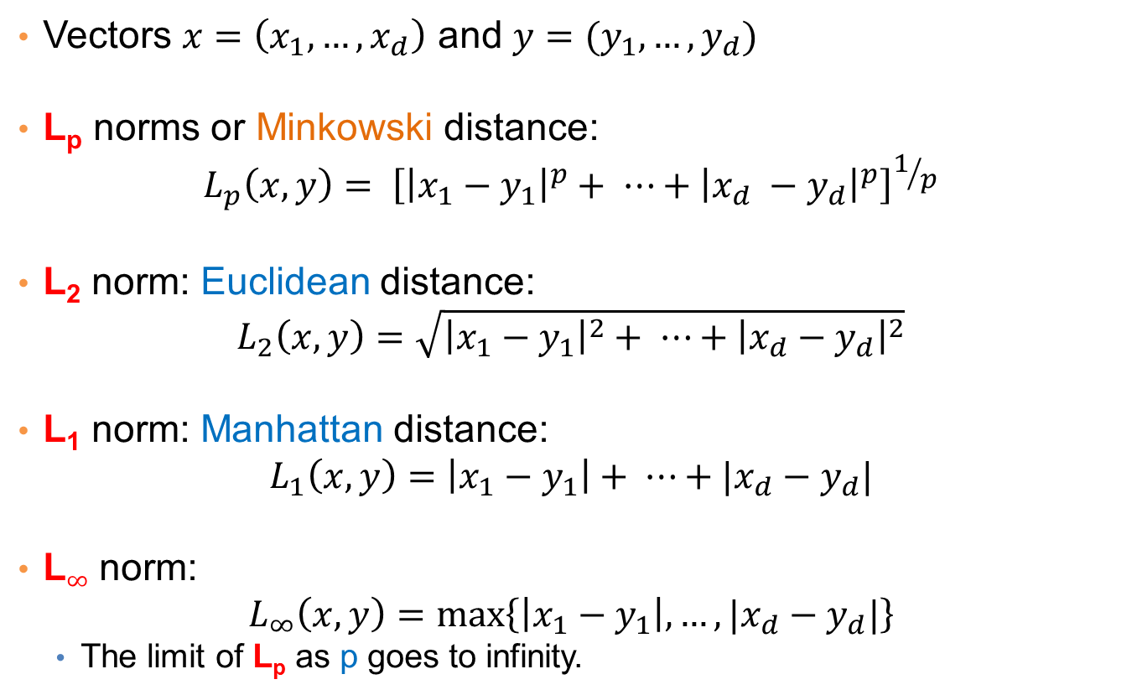
Distances for real vectors
Vectors $x=\left(x_{1},…,x_{d}\right)$ and $y=(y_{1},…,y_{d})$
L_{p} norms or Minkowski distance:
$$L_{p}\left(x,y\right)= {\left[{\left|x_{1}−y_{1}\right|}^{p}+ ⋯+{\left|x_{d} −y_{d}\right|}^{p}\right]}^{1/p}$$
L₂ norm: Euclidean distance:
$$L_{2}\left(x,y\right)=\sqrt{{\left|x_{1}−y_{1}\right|}^{2}+ ⋯+{\left|x_{d}−y_{d}\right|}^{2}}$$
L₁ norm: Manhattan distance:
$$L_{1}\left(x,y\right)=\left|x_{1}−y_{1}\right|+ ⋯+|x_{d}−y_{d}|$$
L$∞$ norm:
$$L_{∞}\left(x,y\right)=\max\left\{\left|x_{1}−y_{1}\right|,…,|x_{d}−y_{d}|\right\}$$
The limit of L_{p} as p goes to infinity.
L_{p} norms are known to be distance metrics

Slide 17
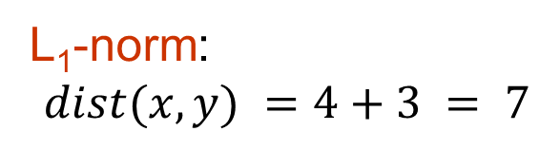
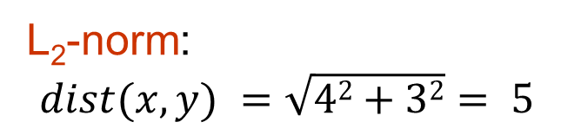
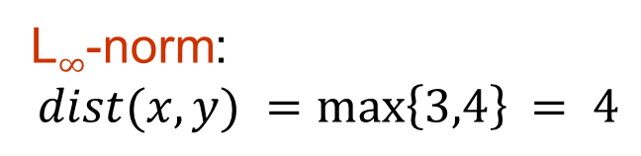
Example of Distances
y = (9,8)
L₂-norm:
$$dist(x,y) =\sqrt{42+32}= 5$$
5
3
L₁-norm:
$$dist(x,y) =4+3 = 7$$
4
x = (5,5)
L$∞$-norm:
$$dist(x,y) =\max\left\{3,4\right\}⁡= 4$$

Slide 18

Example
r
$$x= (x_{1},…,x_{n})$$
Green: All points y at distance L₁(x,y) = r from point x
Blue: All points y at distance L₂(x,y) = r from point x
Red: All points y at distance L$∞$(x,y) = r from point x

Slide 19
L_{p} distances for sets
We can apply all the L_{p} distances to the cases of sets of attributes, with or without counts, if we represent the sets as vectors
E.g., a transaction is a 0/1 vector
E.g., a document is a vector of counts.

Slide 20
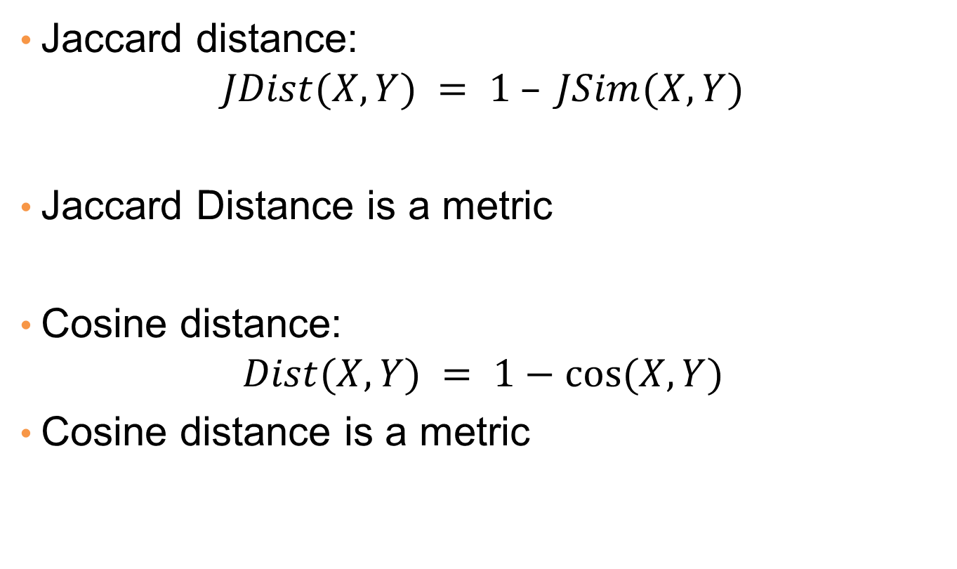
Similarities into distances
Jaccard distance:
$$JDist(X,Y) = 1 – JSim(X,Y)$$
Jaccard Distance is a metric
Cosine distance:
$$Dist(X,Y) = 1−cos⁡(X,Y)$$
Cosine distance is a metric

Slide 21
Why Jaccard Distance Is a Distance Metric
JDist(x,x) = 0
since JSim(x,x) = 1
JDist(x,y) = JDist(y,x)
by symmetry of intersection
JDist(x,y) > 0
since intersection of X,Y cannot be bigger than the union.
Triangle inequality:
Follows from the fact that JSim(X,Y) is the probability of randomly selected element from the union of X and Y to belong to the intersection

Slide 22
Hamming Distance
Hamming distance is the number of positions in which bit-vectors differ.
Example: p₁ = 10101 p₂ = 10011.
d(p₁, p₂) = 2 because the bit-vectors differ in the 3rd and 4th positions.
The L₁ norm for the binary vectors
Hamming distance between two vectors of categorical attributes is the number of positions in which they differ.
Example: x = (married, low income, cheat), y = (single, low income, not cheat)
d(x,y) = 2

Slide 23
Why Hamming Distance Is a Distance Metric
d(x,x) = 0 since no positions differ.
d(x,y) = d(y,x) by symmetry of “different from.”
d(x,y) > 0 since strings cannot differ in a negative number of positions.
Triangle inequality: changing x to z and then to y is one way to change x to y.
For binary vectors if follows from the fact that L₁ norm is a metric

Slide 24
Distance between strings
How do we define similarity between strings?
Important for recognizing and correcting typing errors and analyzing DNA sequences.
weird wierd
intelligent unintelligent
Athena Athina

Slide 25
Edit Distance for strings
The edit distance of two strings is the number of inserts and deletes of characters needed to turn one into the other.
Example: x = abcde ; y = bcduve.
Turn x into y by deleting a, then inserting u and v after d.
Edit distance = 3.
Minimum number of operations can be computed using dynamic programming
Common distance measure for comparing DNA sequences

Slide 26
Why Edit Distance Is a Distance Metric
d(x,x) = 0 because 0 edits suffice.
d(x,y) = d(y,x) because insert/delete are inverses of each other.
d(x,y) > 0: no notion of negative edits.
Triangle inequality: changing x to z and then to y is one way to change x to y. The minimum is no more than that

Slide 27
Variant Edit Distances
Allow insert, delete, and mutate.
Change one character into another.
Minimum number of inserts, deletes, and mutates also forms a distance measure.
Same for any set of operations on strings.
Example: substring reversal or block transposition OK for DNA sequences
Example: character transposition is used for spelling

Slide 28
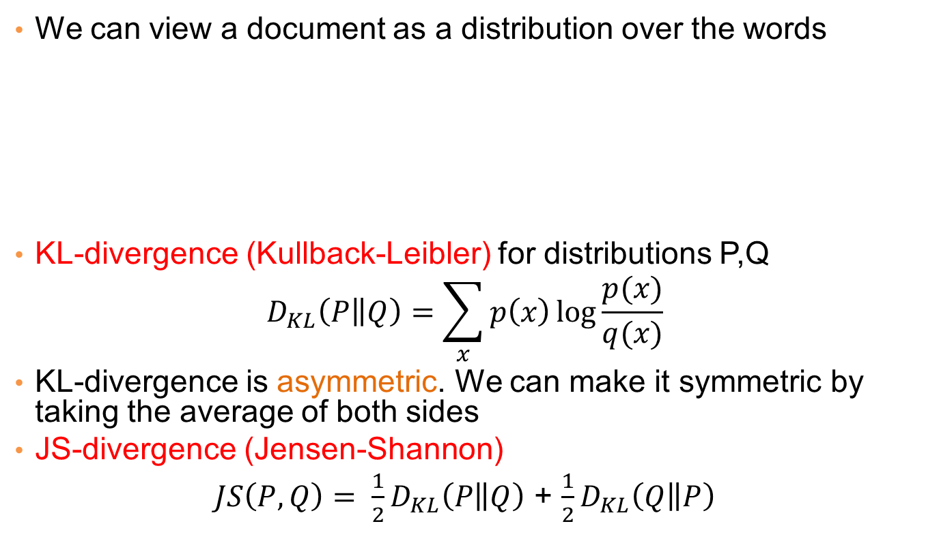
Distances between distributions
We can view a document as a distribution over the words
KL-divergence (Kullback-Leibler) for distributions P,Q
$$D_{KL}\left(P\left\|Q\right.\right)=\sum_{x}{p\left(x\right)\log{\frac{p(x)}{q(x)}}}$$
KL-divergence is asymmetric. We can make it symmetric by taking the average of both sides
JS-divergence (Jensen-Shannon)
$JS\left(P,Q\right)= \frac{1}{2}D_{KL}\left(P\left\|Q\right.\right)$ + $\frac{1}{2}D_{KL}\left(Q\left\|P\right.\right)$
document | Apple | Microsoft | Obama | Election
D1 | 0.35 | 0.5 | 0.1 | 0.05
D2 | 0.4 | 0.4 | 0.1 | 0.1
D2 | 0.05 | 0.05 | 0.6 | 0.3

Slide 29
SKETCHING AND LOCALITY SENSITIVE HASHING
Thanks to:
Rajaraman and Ullman, “Mining Massive Datasets”
Evimaria Terzi, slides for Data Mining Course.

Slide 30
Why is similarity important?
We saw many definitions of similarity and distance
How do we make use of similarity in practice?
What issues do we have to deal with?

Slide 31
An important problem
Recommendation systems
When a user buys an item (initially books) we want to recommend other items that the user may like
When a user rates a movie, we want to recommend movies that the user may like
When a user likes a song, we want to recommend other songs that they may like
A big success of data mining
Exploits the long tail

Slide 32
Recommendation Systems
Content-based:
Represent the items into a feature space and recommend items to customer C similar to previous items rated highly by C
Movie recommendations: recommend movies with same actor(s), director, genre, …
Websites, blogs, news: recommend other sites with “similar” content

Slide 33
Plan of action
Item profiles
likes
build
recommend
match
Red
Circles
Triangles
User profile

Slide 34
Limitations of content-based approach
Finding the appropriate features
e.g., images, movies, music
Overspecialization
Never recommends items outside user’s content profile
People might have multiple interests
Recommendations for new users
How to build a profile?

Slide 35
Recommendation Systems (II)
Collaborative Filtering (user –user)
Consider user c
Find set D of other users whose ratings are “similar” to c’s ratings
Estimate user’s ratings based on ratings of users in D

Slide 36
Recommendation Systems (III)
Collaborative filtering (item-item)
For item s, find other similar items
Estimate rating for item based on ratings for similar items
Can use same similarity metrics and prediction functions as in user-user model
In practice, it has been observed that item-item often works better than user-user

Slide 37
Pros and cons of collaborative filtering
Works for any kind of item
No feature selection needed
New user problem
New item problem
Sparsity of rating matrix
Cluster-based smoothing?

Slide 38
Another important problem
Find duplicate and near-duplicate documents from a web crawl.
Why is it important:
Identify mirrored web pages, and avoid indexing them, or serving them multiple times
Find replicated news stories and cluster them under a single story.
Identify plagiarism
What if we wanted exact duplicates?

Slide 39
Finding similar items
Both the problems we described have a common component
We need a quick way to find highly similar items to a query item
OR, we need a method for finding all pairs of items that are highly similar.
Also known as the Nearest Neighbor problem, or the All Nearest Neighbors problem
We will examine it for the case of near-duplicate web documents.

Slide 40
Main issues
What is the right representation of the document when we check for similarity?
E.g., representing a document as a set of characters will not do (why?)
When we have billions of documents, keeping the full text in memory is not an option.
We need to find a shorter representation
How do we do pairwise comparisons of billions of documents?
If exact match was the issue it would be ok, can we replicate this idea?

